Slide 1
Unit 6-6

Slide 2
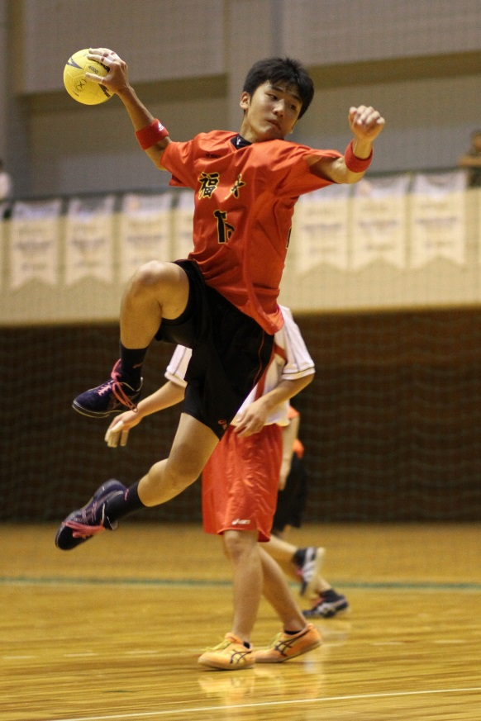
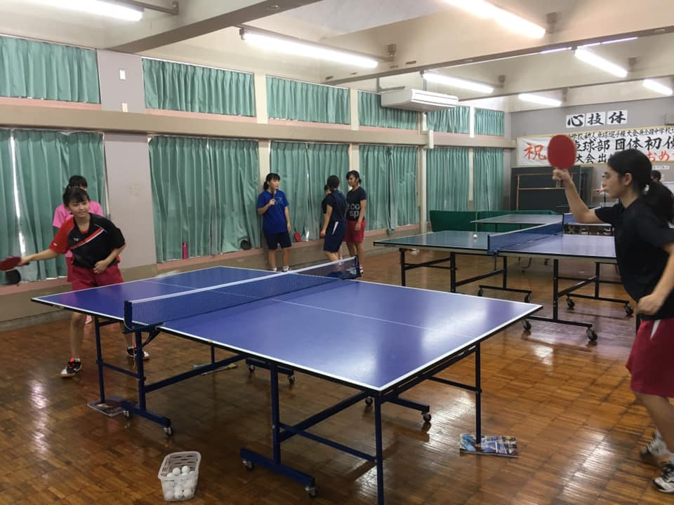
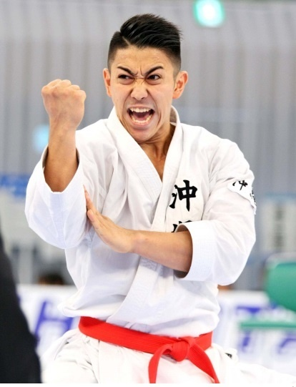
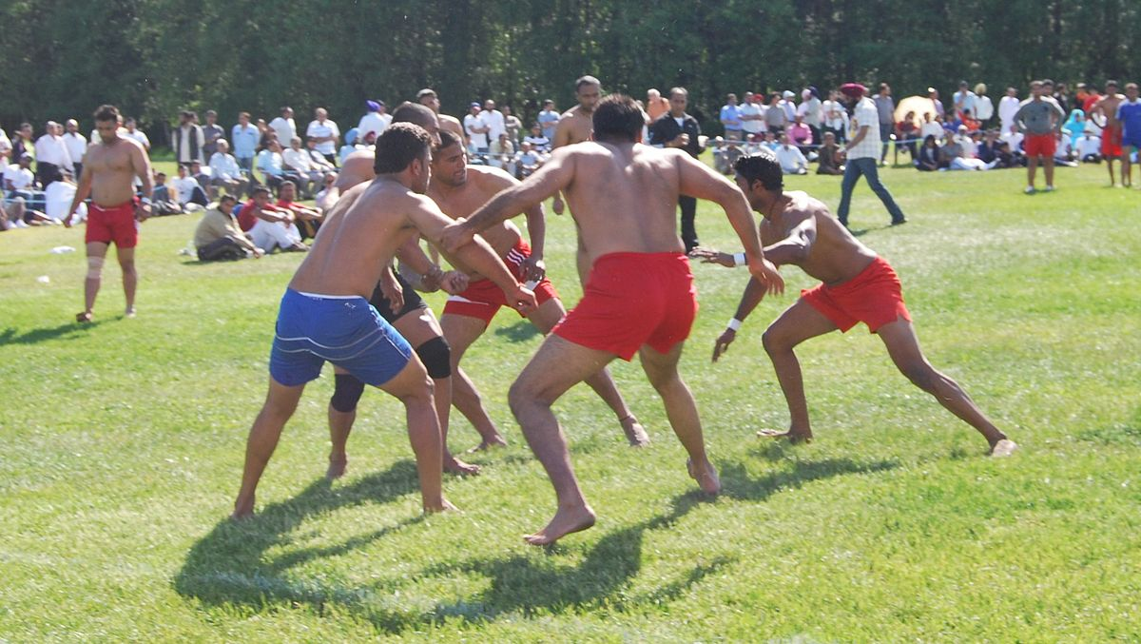
Where are these sports from?
baseball
handball
table tennis
kabadhi
tennis
karate

Slide 3
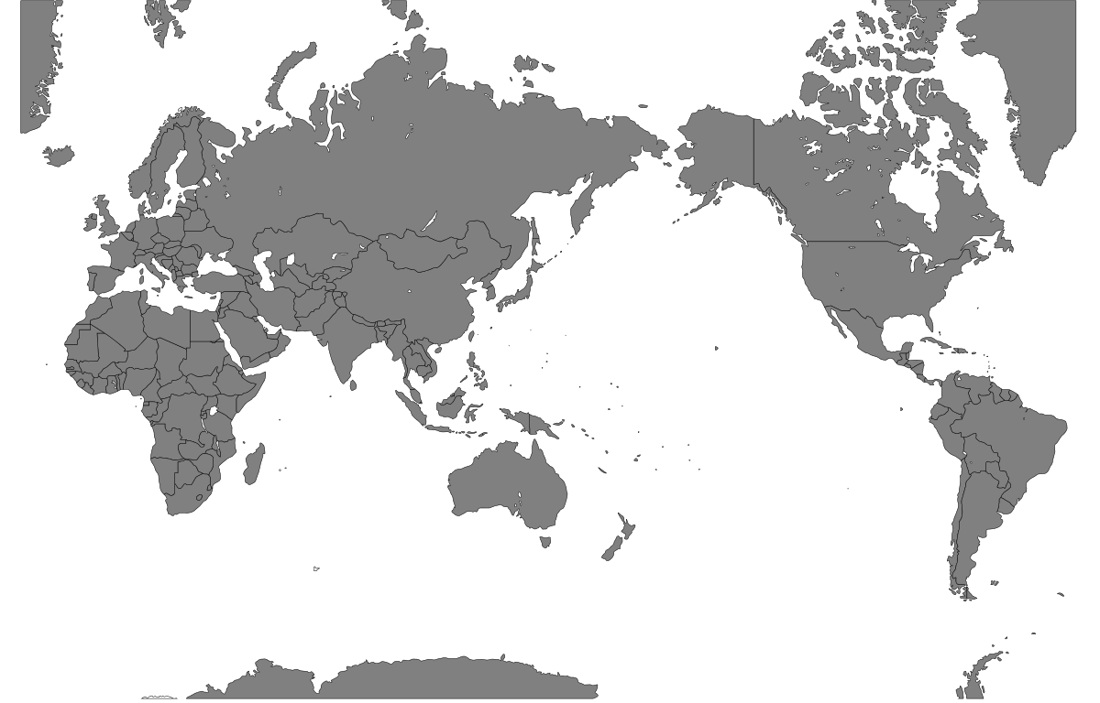
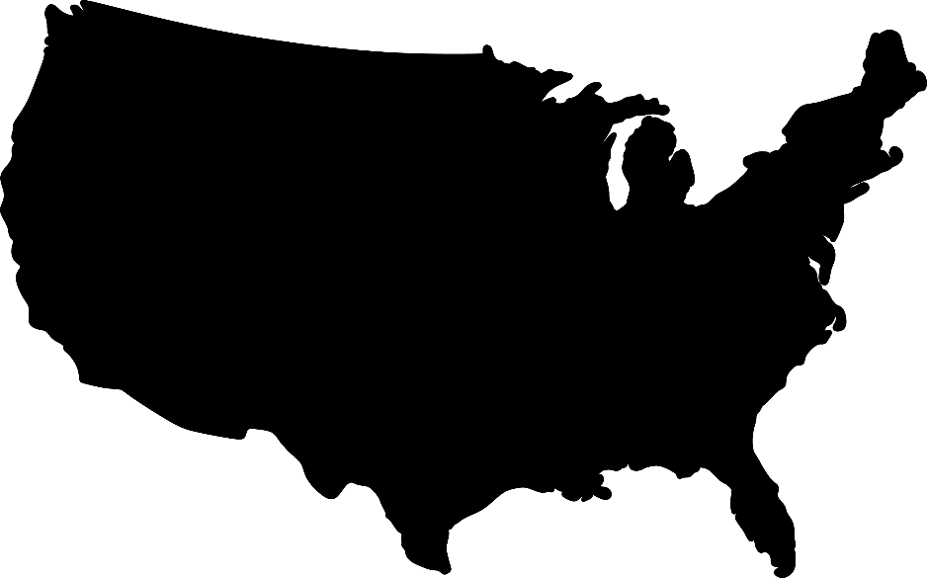
Baseball is from
The U.S.

Slide 4
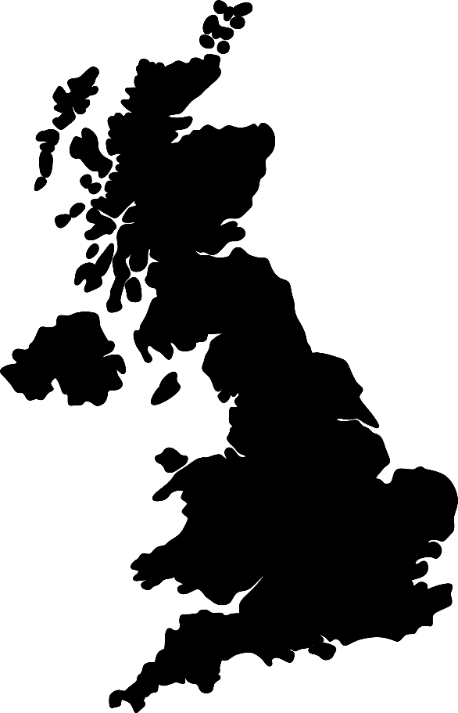
Table tennis is from
England

Slide 5
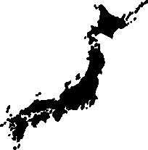
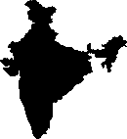
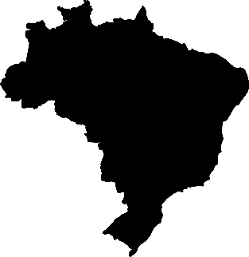
Where is ____from?
Ireland
India
Egypt
Japan
South Africa
Brazil

Slide 6
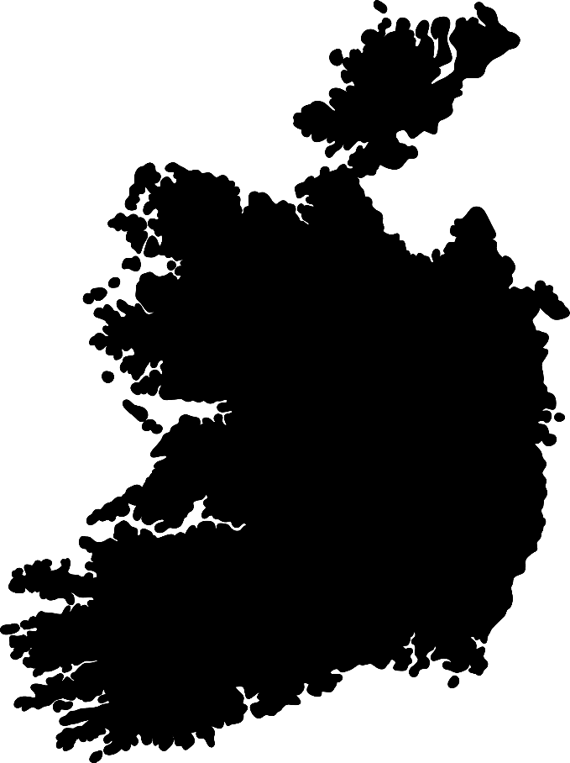
Handball is from
Ireland

Slide 7
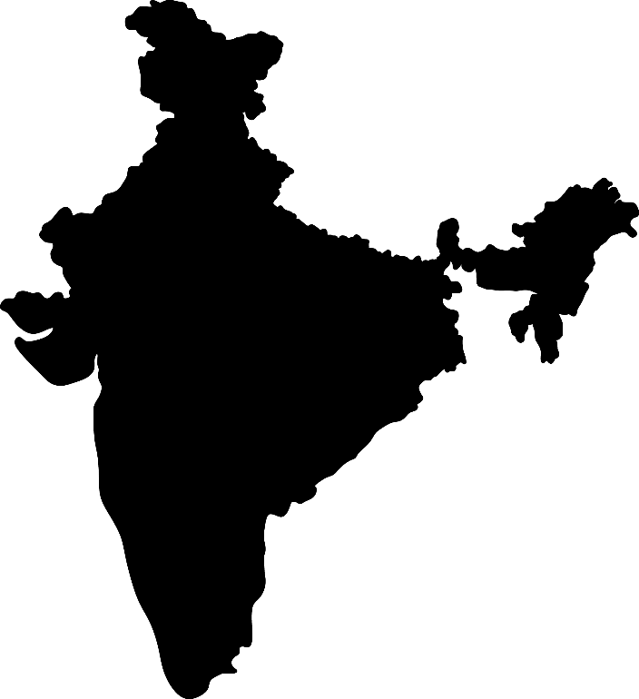
Kabadhi is from
India

Slide 8
Tennis is from
Egypt

Slide 9
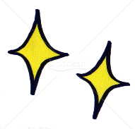
Karate is from
Okinawa

Slide 10
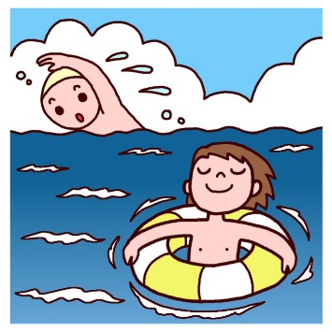
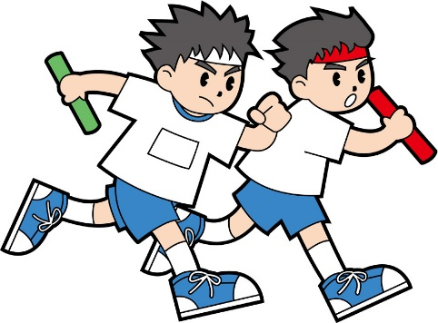
Short Reading ①
Yumato is a soccer player and Asami is a swimmer.
They run very fast. They practice relay and
marathon hard every day. They went to Miyako
Island to join All Okinawa Track & Field Competition.
A
B

Slide 11
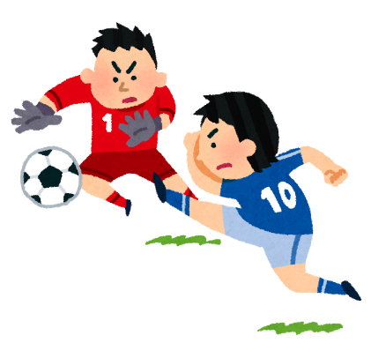
Short reading②
B
T: Hey Roberto, please help me reading this poster.
It’s Italian.
R: Oh, “calcio”! I like this sport!
T: What is “calcio”?
R: You don’t know “calcio”!? It’s very popular in Italy.
Everyone loves it.
T: I don’t know… Is it like rugby?
R: You can kick the ball like rugby, but in “calcio”,
you must not use hands.
I think you played it when you were a student.
Takemi: Oh, I see! Playing “calcio” is so much fun!

Slide 12
Let’s read about Olympic sports!
What are these sports?
① Read by yourself （一人で読む） 2min
② Share with your group（グループでシェア）
③ Read more and underline information 20min
（大事な情報に下線）
If you have time, try other sports!

Slide 14
A
It is the No. 1 popular sport in the world. There are 250,000,000 players in over 200 countries. On the field, there is a goal at each end, and players kick a ball. It is played between two teams. Each team has eleven players. Players can use all body, but they must not touch the ball with their hands and arms. Only goalkeepers can use their hands.

Slide 15
Soccer

Slide 16
B
This sport is from the U.K. but No.1 team is Serbia. This sport is played in the pool, but it’s not a swimming race. This is a team sport. There are six players and a goalkeeper. They use a ball, and players need to throw the ball in the goal. It is played in the water, and players use their hands, so some people call it “water handball”.

Slide 17
Water polo

Slide 18
C
This is a very hard sport. It takes over two hours. This race started with the first Olympic game. At first, women couldn’t join it because people thought it was too hard for them. Each person has to run for 42.195km. But they wanted to join. In 1972, women were allowed to join the race. No.1 runners in the world are Kipchoge and Kosgey. They are both from Kenya.

Slide 19
Marathon

Slide 20
D
It is a team sport. It was born in America in 1891. There are two hoops as goals in the court. It looks like soccer, but players cannot kick the ball. American National team is No.1 in the world now. There are five players each team on the court. They can change the members as they like. They can get points when they shoot a ball in the hoop. The hoops are 305 centimeters high.

Slide 21
Basketball

Slide 22
E
This sport is from Europe, very popular in especially Italy and France. It is played by two persons. They play it on a fourteen-meters-long stage. They have swords. This sport looks like Kendo. Their uniforms are white. They wear protectors, gloves, and masks. They need to attack the body with the swords. Now electrical referee machines judge the games.

Slide 23
Fencing

Slide 24
F
It is a game played between two players in the singles game. But there is a doubles game too. In doubles game, there are two teams of two players. It is played worldwide. Players use a racket and a small ball. The four Grand Slam tournaments are especially popular: the Australian Open played on hard courts, the French Open played on red clay courts, Wimbledon played on grass courts, and the US Open also played on hard courts.

Slide 25
Tennis

Slide 26
G
The sport is a team sport. Two teams of six players are separated by a net. Each team tries to score points by hitting a ball on the other team’s court．You can touch the ball only three times. In this sport, spiking is the act of scoring a point by slamming the ball over the net into the opposing court effectively and aggressively. The sport’s tournaments at the 2020 Summer Olympics in Tokyo will take place at Ariake Arena in Tokyo.

Slide 27
Volleyball

